Slide 1
Image Classification
With CNN
Group - 5
Ahmad - Georg - Matheus - Sofia

Slide 2
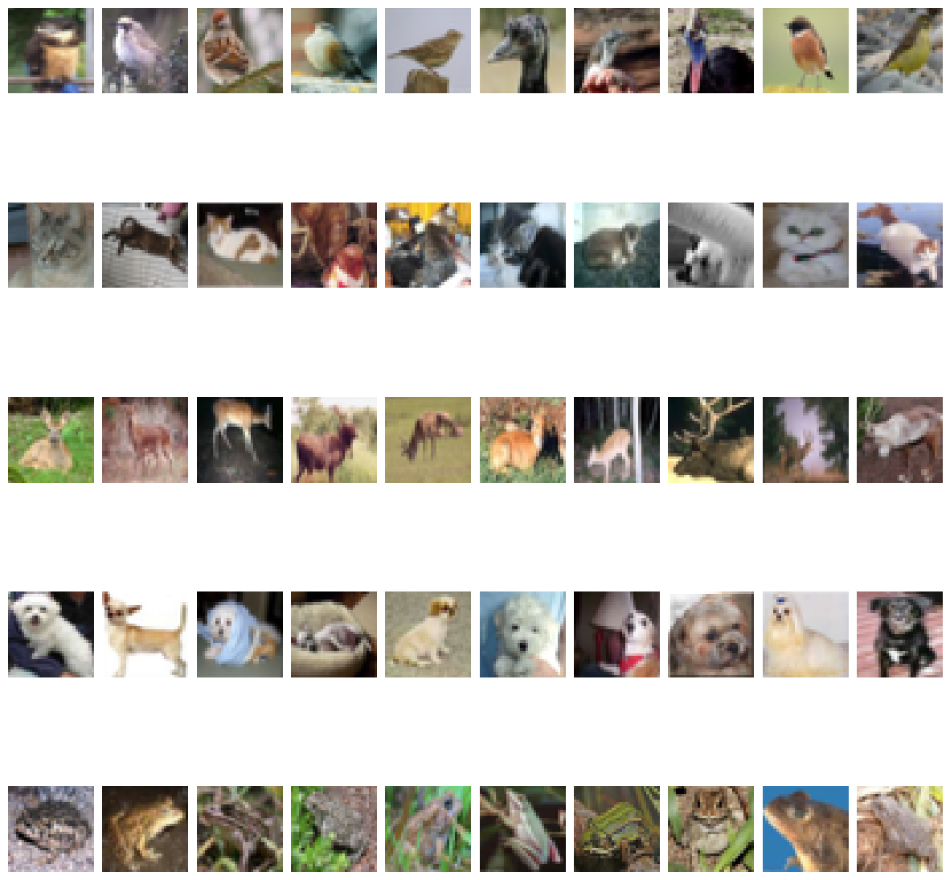
Methods (preprocessing) ⚙️
Sample of the selected classes
Dataset Used: CIFAR-10
Reviewed all dataset classes and organized them into training vectors.
Converted class labels into one-hot encoding for model compatibility.
Filtered the dataset to include only animal classes
Remapped class indexes accordingly
Model Evaluation: Training on animal classes showed no significant overfitting in our experiments.

Slide 3
Model Evaluation 📊
Trained models on the animal subset.
Observed no significant overfitting in experiments
Evaluated multiple architectures to find best performance

Slide 4
Experiments Overview 🔬
We tested multiple CNN-based approaches:
Simple CNN
MobileNetV2 (Transfer Learning)
CNN with Data Augmentation
ResNet
Each experiment aimed to improve model accuracy and reduce loss.

Slide 5
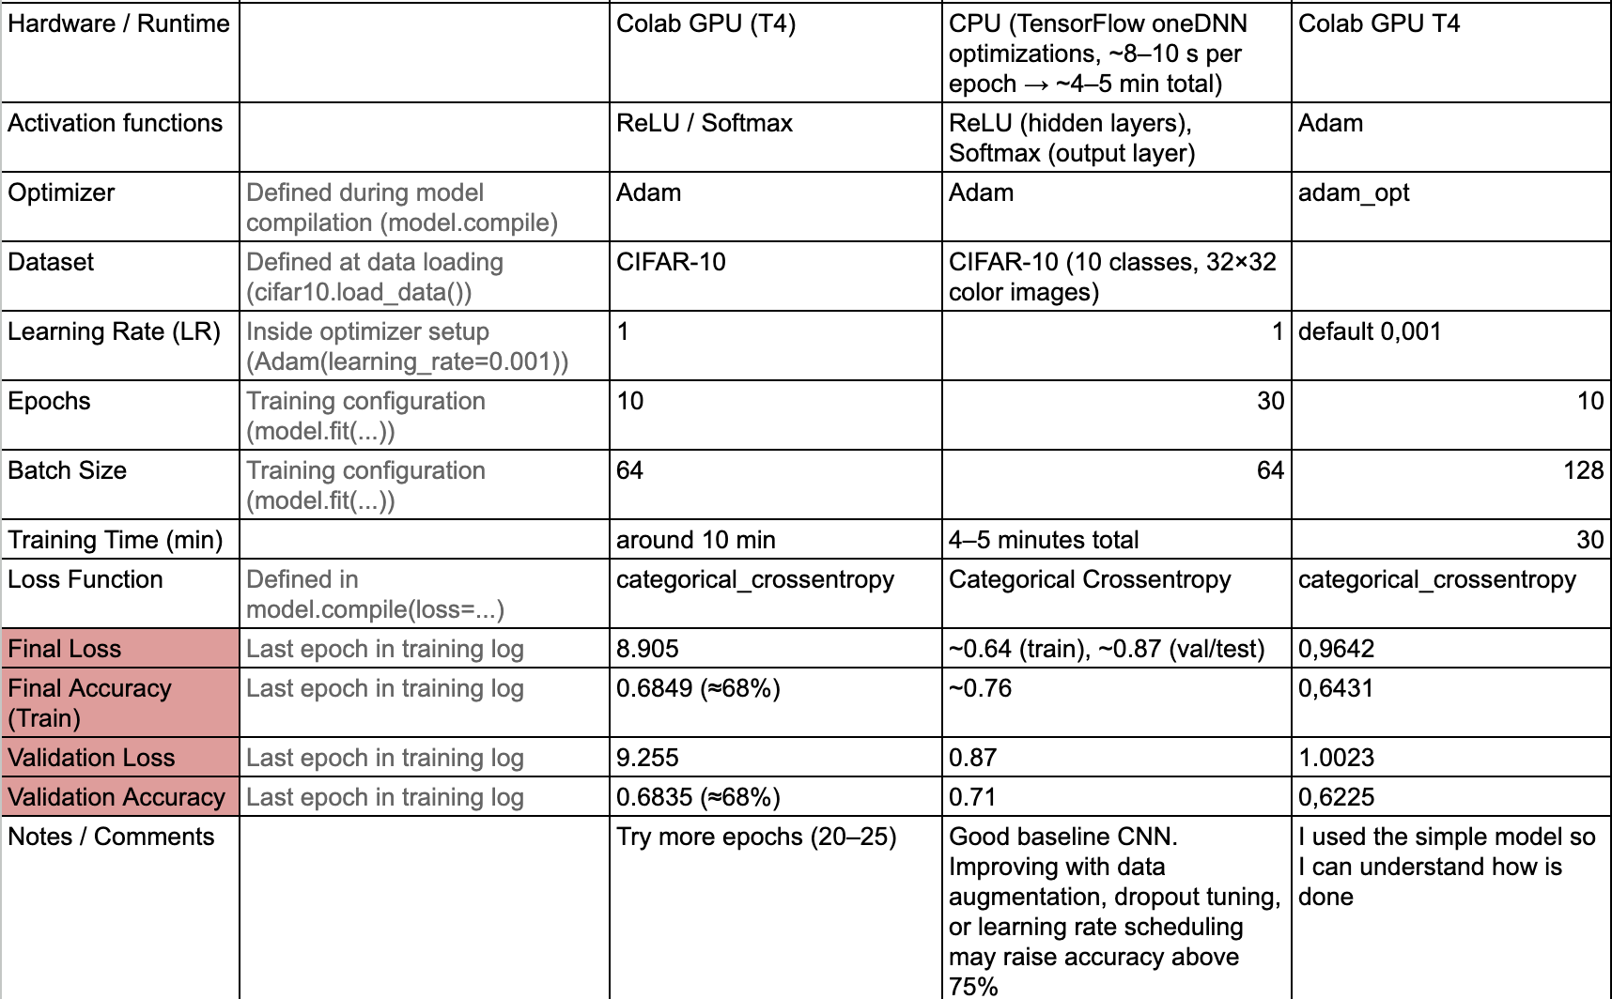
Image Classification - Simple CNN
📷🔍
Configuration: 10 epochs, batch size 64, Adam optimizer, ReLU & Softmax activation, 4 neuron layers.
Results:
Training Accuracy: 0.6849 | Loss: 8.905
Validation Accuracy: 0.6835 | Loss: 9.255
Observation: Basic CNN performed reasonably but showed high loss, suggesting room for improvement (possible main causes: underfitting or lack of model depth)
Metrics - Parameters Example:

Slide 6
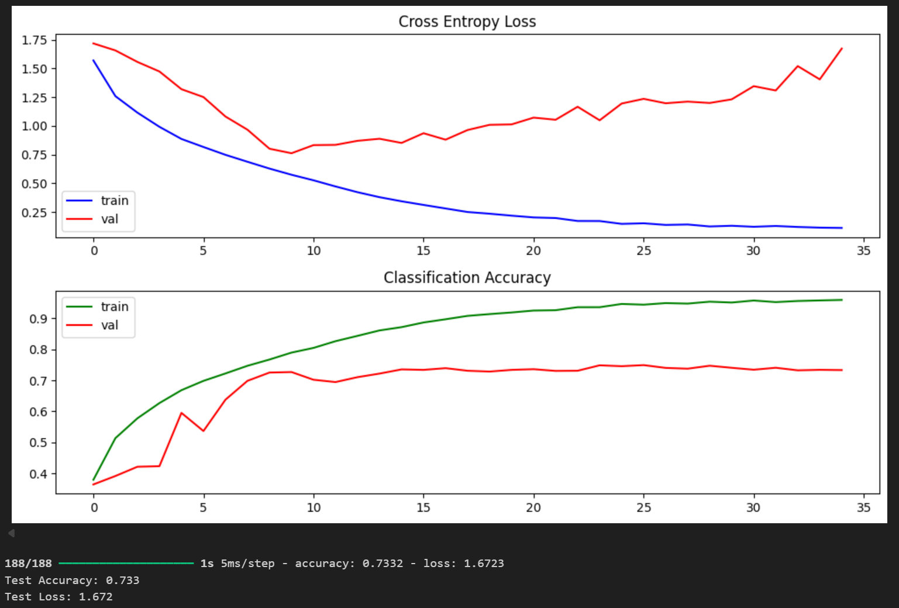
Image Classification - VGG-Style CNN
📷🧱
Configuration: 45 epochs, batch size 512, Adam optimizer (learning rate = 0.001), ReLU & Softmax activation, 11 convolutional + dense layers
Results:
Training Accuracy: 0.733 | Loss: 1.672
Observation: The VGG-style CNN showed improved accuracy compared to the simple CNN. Training was more stable due to batch normalization, but the model still displayed moderate loss — indicating potential for further optimization or regularization.

Slide 7
Image Classification - CNN with Data Augmentation - Early Stopping 📷✨
Configuration: 50 epochs, batch size 128, Adam optimizer (learning rate = 0.001), ReLU & Softmax activation, 4 convolutional + dense layers
Results:
Training Accuracy: 0.8505 (~85%) | Loss: 0.3791 (38%)
Validation Accuracy: 0.6892 (~69%) | Loss: 1.1196
Observation: Data augmentation helped slightly improve validation performance, and early stopping prevented overfitting.

Slide 8
Image Classification with Resnet
📷📈
Core Concept
Addressing Vanishing Gradient: Allows models to learn identity functions.
Forward Original Inputs: Enables unchanged re-passing of inputs.
Benefits
Simplified Learning: Easier adjustments when function complexity is unnecessary.
Stable Gradient: Enhances training efficiency in deeper networks.
High Efficiency and Accuracy: Facilitates effective model construction

Slide 9
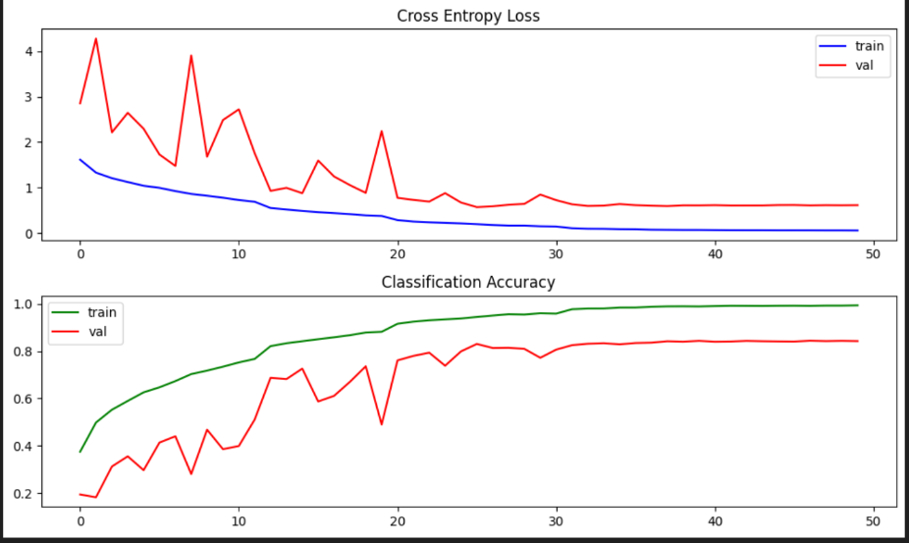

Resnet Model 📈
Optimizer: Adam optimizer is used with the default learning rate of 0.001.
Loss Function: The model uses categorical crossentropy to compute the loss.
Learning Rate Scheduler: The learning rate is reduced by a factor of 0.4 if validation loss does not improve over 5 epochs.

Slide 10
Image Classification – Transfer Learning with VGG16
🧠🔄
Configuration: 10 epochs, batch size 64, Adam optimizer (learning rate = 0.001), ReLU & Softmax activation, VGG16 convolutional base frozen + custom classifier (Flatten, Dense 128, Dropout 0.5, Dense 10 softmax)
Results:
Training Accuracy: 0.5916 (~59%) | Loss: 1.1737
Validation Accuracy: 0.5968 (~60%) | Loss: 1.1530
Observation: Using transfer learning allowed the model to leverage pre-trained features, which improved performance and reduced training time. This approach is particularly useful when working with limited data, and it showed good validation accuracy while learning efficiently.

Slide 11
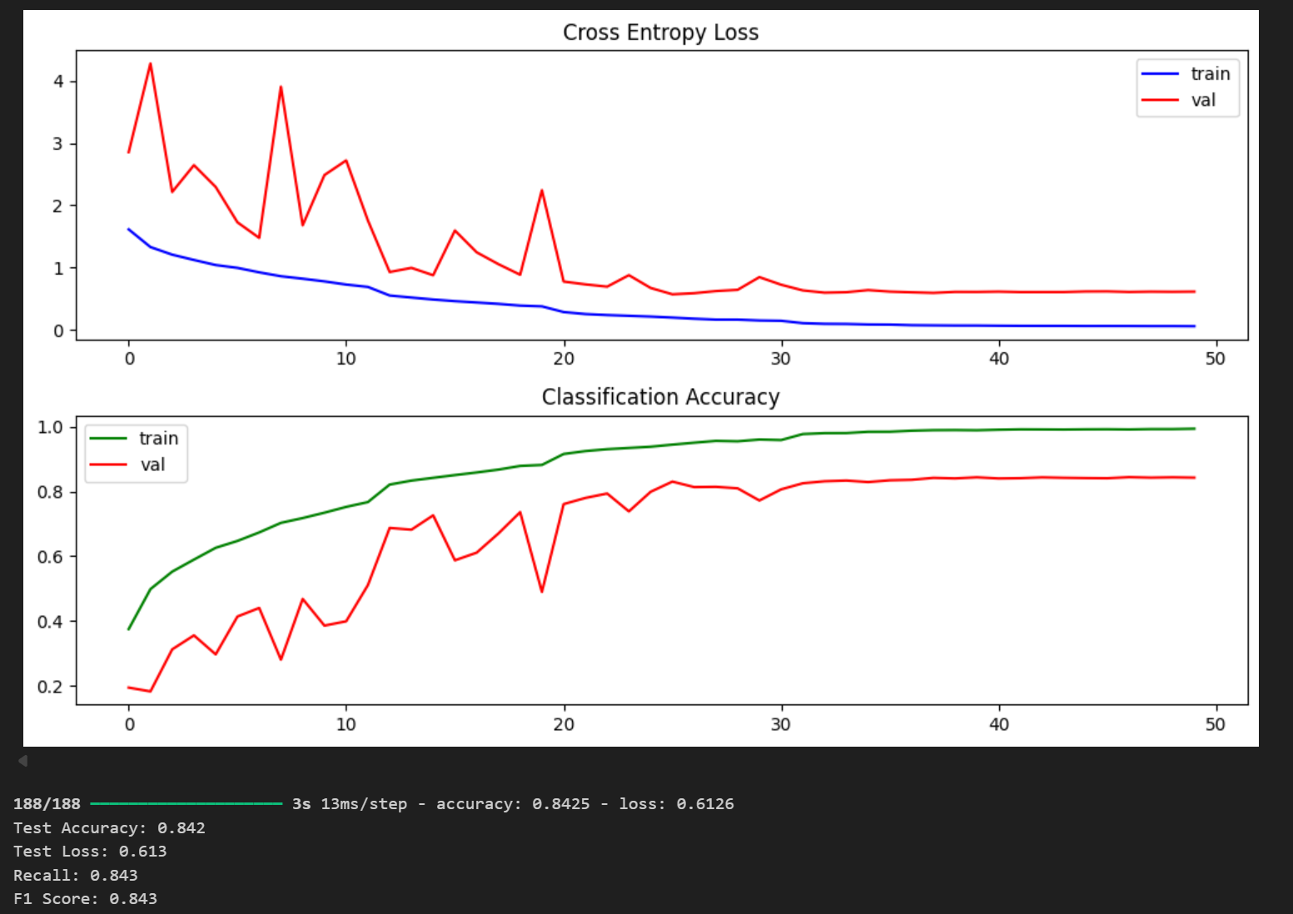
Winning Model 🏆
Best Model: ResNet
Accuracy: 0.8425 | Loss: 0.6126
Quick recap of alternatives:
Simple CNN
MobileNetV2 (Transfer Learning)
CNN with Data Augmentation
Key Observations:
ResNet outperformed all other models in both accuracy and stability.
Adding batch normalization in simpler CNNs improved training stability and reduced loss, highlighting the importance of normalization in deep learning.

Slide 12
Takeaways 🔑
Residual connections in ResNet improve learning for deeper networks.
Outperformed simple CNN and augmented CNN.
Recap / Conclusions
ResNet is the most effective model for CIFAR-10 classification.
Data augmentation improves generalization but alone is insufficient.
Batch normalization in simple CNN boosts performance.
Transfer learning: no good results on the dataset
Challenges
Overfitting when training on limited subsets of data.
High loss with simple CNN, even with small architectures.
Choosing optimal hyperparameters (batch size, learning rate, epochs).
Key Learnings
Preprocessing (one-hot encoding, normalization) is crucial for CNNs.
Data augmentation mitigates overfitting but doesn’t fully replace model complexity.
Deep architectures like ResNet handle vanishing gradient and outperform shallow networks.
Combining batch normalization and advanced architectures yields the best results.

Slide 13
Closing Remarks ✍️
Our image classification project demonstrated the power of deep learning and the impact of architectural choices on model performance. Through multiple experiments — from a simple CNN to data augmentation and ResNet — we observed clear improvements in accuracy, stability, and generalization.
The journey showed that:
Small adjustments like batch normalization and augmentation can make a significant difference.
ResNet’s residual learning architecture remains one of the most reliable methods for image classification.
Continuous experimentation and fine-tuning are key to achieving high performance in real-world applications.
Final Thoughts
“In deep learning, progress comes not only from deeper models — but from deeper understanding.”

